Slide 1
PHISHING URL DETECTION USING MACHINE LEARNING
Rishikesh, Sreetama Das, Chayan Ghosh, Souparna Paul
Under the Supervision of
Dr. Chandrima Chakrabarti
Associate Professor & Head
Dept. of CSE Data Science
Narula Institute of Technology
14-05-2025
RAICCIT 2025 | JIS University | Slide 1

Slide 2
Introduction
Phishing attacks deceive users into sharing sensitive information via fake websites.
This project proposes a machine learning-based system to detect phishing URLs.
Traditional methods (e.g., blacklists) are ineffective against evolving phishing tactics.
The proposed system offers automated, accurate, and scalable phishing detection.
It enhances cybersecurity by reducing manual effort and improving response time.
Can machine learning accurately classify URLs as phishing or legitimate?
Objective: Develop and evaluate ML models (e.g., Random Forest, SVM) for phishing URL detection and enable real-world deployment.

Slide 3
Literature Review
Traditional methods like blacklists and heuristics are limited against zero-day phishing attacks.
Machine learning models (e.g., Random Forest, SVM) offer better accuracy by learning URL patterns from data.
Deep learning improves detection but requires heavy resources and lacks transparency.
Gaps exist in real-time performance, scalability, and model interpretability.
This project bridges the gap by combining efficient feature selection, robust ML models, and deployable architecture for real-world use.

Slide 4
Research Design and Methods
This project follows an experimental research design using machine learning techniques to detect phishing URLs. A labelled dataset containing legitimate and phishing URLs is used for training and testing.
Data Collection: URLs with extracted features (e.g., length, domain, special characters) were sourced from publicly available datasets.
Participants: No human participants involved; the study uses existing datasets.
Materials & Tools:
Python with libraries like pandas, scikit-learn, and pickle.
Jupyter Notebook for model development.

Slide 5
Research Design and Methods
Procedure:
Data preprocessing and feature selection.
Training models like Random Forest and SVM.
Model evaluation using accuracy, precision, recall, and F1-score.
Saving and deploying the best model for real-time phishing detection.
Algorithm: Training and Deploying a Phishing URL Detection Model
1. Start.
2. Import required libraries, including NumPy, pandas, sklearn (StandardScaler, train_test_split, classifiers, GridSearchCV), and pickle.
3. Load the dataset containing URL features and labels (phishing or legitimate)

Slide 6
Research Design and Methods
4. Preprocess the data by handling missing values, mapping target labels (phishing as 1 and legitimate as 0), and selecting significant features based on their correlation with the target variable.
5. Split the dataset into training and testing sets and normalize features using StandardScaler.
6. Train machine learning models like Logistic Regression and Random Forest, and use GridSearchCV for hyperparameter tuning.
7. Evaluate the trained models by making predictions on the test set, calculating metrics such as accuracy, precision, recall, and F1 score, and selecting the best-performing model.
8. Save the trained model and the feature scaler using pickle for deployment.
9. Deploy the saved model in a web application to classify URLs as phishing or legitimate based on input features.
10. Stop.

Slide 7
Results
The summary table provided gives a concise comparison of the performance and configuration of all the machine learning models used in your phishing URL detection project.
Let’s break down each column in the table to understand it better:
Model | Best Parameters | CV Accuracy | Test Accuracy
Logistic Regression | C=10 | 93.21% | 93.84%
Random Forest | n_estimators=200, max_depth=20 | 96.10% | 96.12%
Gradient Boosting | n_estimators=200, learning_rate=0.1 | 95.89% | 95.87%
SVM | C=10, kernel='rbf' | 95.64% | 96.22%
KNN | n_neighbors=3, p=1 | 95.10% | ~95% (est.)

Slide 8
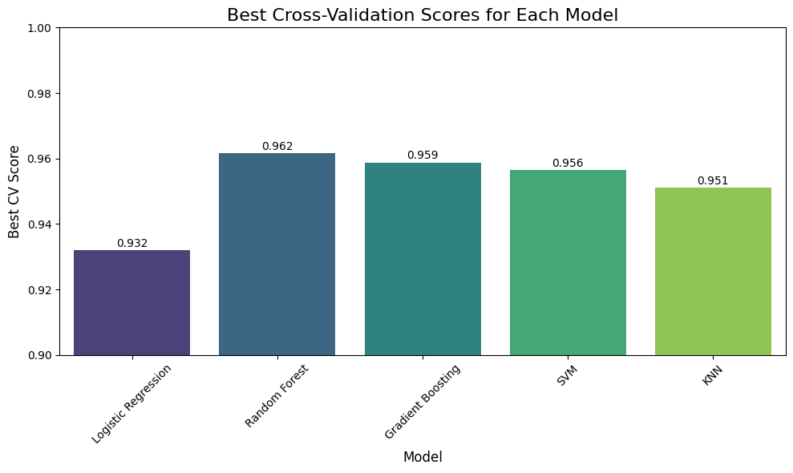
Results
Figure1

Slide 9
Results
In Figure1: The bar chart titled "Best Cross-Validation Scores for Each Model" compares the performance of five machine learning models: Logistic Regression, Random Forest, Gradient Boosting, SVM, and KNN. The models were evaluated using cross-validation to assess their ability to generalize to unseen data.
Random Forest achieved the highest cross-validation score, suggesting it might be the most effective model for this dataset. Gradient Boosting and SVM also performed well, while Logistic Regression and KNN showed lower scores.

Slide 10
Discussion
The high accuracy of the model shows that machine learning is effective for phishing URL detection.
It can be integrated into real-world tools like browsers and email filters to improve cybersecurity.
The project’s novelty lies in combining strong feature selection with practical deployment using a web app.
It addresses gaps in earlier methods by being scalable, real-time, and adaptable to new phishing tactics.

Slide 11
Conclusion
The project successfully developed a machine learning-based phishing URL detector with high accuracy.
It proves that data-driven models can outperform traditional methods in detecting phishing attacks.
With real-time detection and deployment potential, this system can enhance cybersecurity across platforms.
The research contributes to building safer digital environments by addressing modern phishing threats.

Slide 12
References
Eswar Chand, “Phishing Website Detector Dataset,” Kaggle, https://www.kaggle.com/datasets/eswarchandt/phishing-website-detector, Accessed Dec. 2024.
T. Kim, N. Park, J. Hong, and S. W. Kim, “Phishing URL detection: A network-based approach robust to evasion,” Proc. 2022 ACM SIGSAC Conf. Comput. Commun. Secur., pp. 1769-1782, Nov. 2022.R. Solanki, “Principle of Data Mining,” McGraw-Hill Publication, India, pp. 386-398, 1998.
S. H. Ahammad, S. D. Kale, G. D. Upadhye, S. D. Pande, E. V. Babu, A. V. Dhumane, and M. D. K. J. Bahadur, “Phishing URL detection using machine learning methods,” Adv. Eng. Softw., vol. 173, p. 103288, 2022.
Lee, J., Kim, M., and Park, H., "Phishing Detection Techniques and Their Effectiveness: A Comprehensive Survey," IEEE Transactions on Information Security, vol. 17, no. 2, pp. 87-98, Feb. 2023.

Slide 13
THANK YOU

